Slide 1
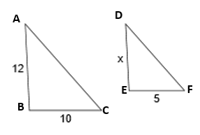
4
A $∆$ABC is similar to $∆ DEF$. Find x
__________________________________________________________

Slide 2
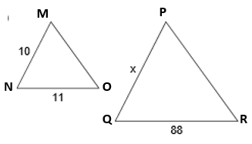

5
B $∆ MNO \sim ∆ PQR$
Find x
__________________________________________________________

Slide 3
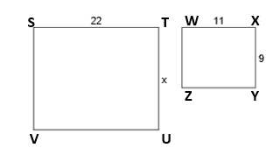
12
C Rectangle STUV is similar to WXYZ. Find x
__________________________________________________________

Slide 4
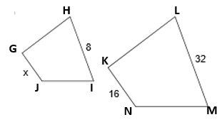
18
D Quadrilateral GHIJ $\sim$ Quadrilateral KLMN
Find x.
__________________________________________________________

Slide 5
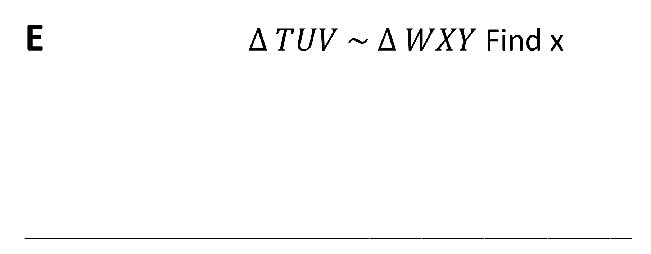
143
E $∆ TUV \sim ∆ WXY$Find x
__________________________________________________________

Slide 6
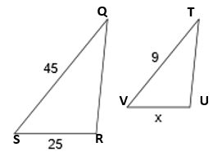

68
F $∆QRS \sim ∆TUV$ Find x.
__________________________________________________________

Slide 7
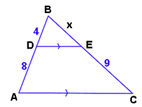

14
G $∆ ABC\sim DBE$ Find x
__________________________________________________________

Slide 8
16
H
__________________________________________________________

Slide 9
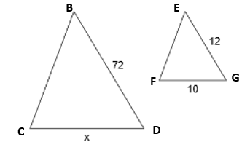
100
I Triangle BCD is similar to triangle EFG. Find x
__________________________________________________________

Slide 10
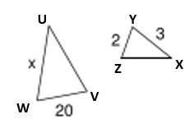
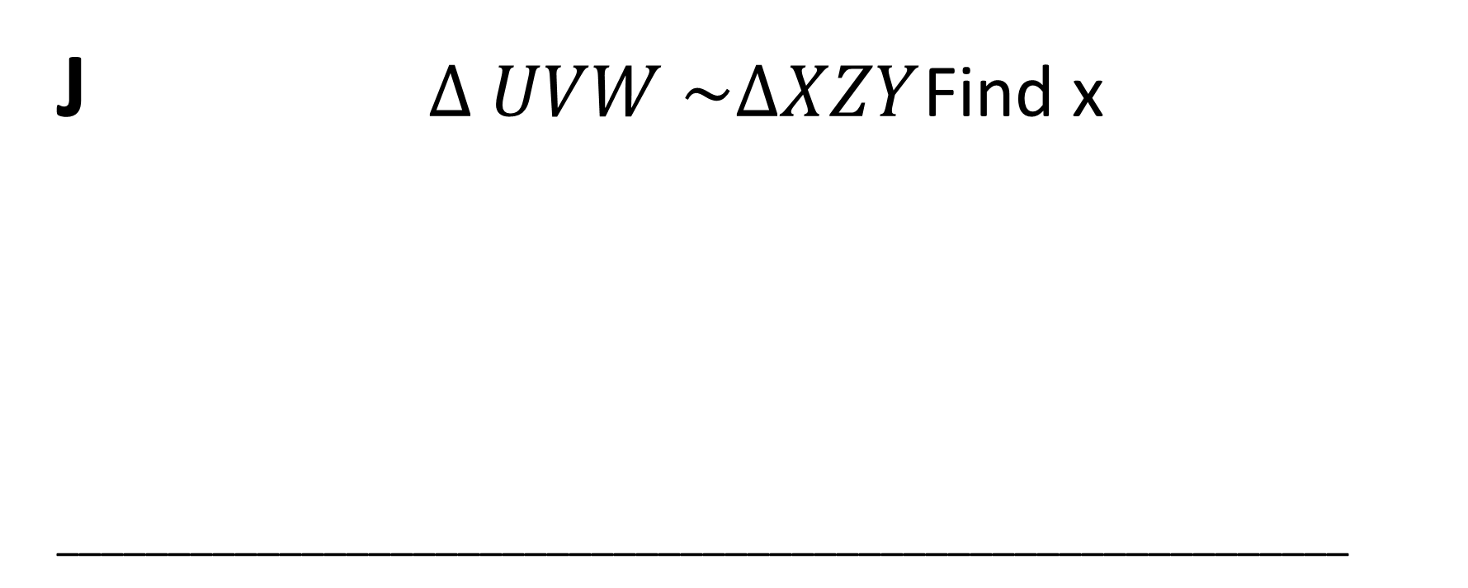
10
J $∆ UVW \sim ∆XZY$ Find x
__________________________________________________________

Slide 11
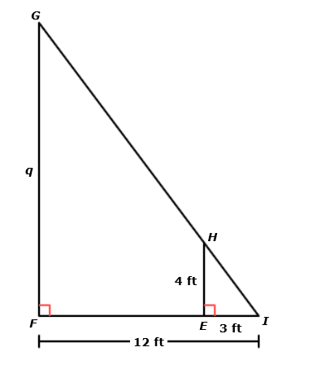

9
K $∆ IHE \sim ∆IGF$ Find q
__________________________________________________________

Slide 12
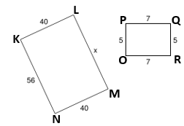
69
L Rectangle KLMN is similar to OPQR Find x
__________________________________________________________

Slide 13
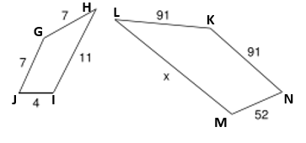
4.5
M Quadrilateral GHIJ $\sim$Quadrilateral KLMN Find x
__________________________________________________________

Slide 14
7
N
__________________________________________________________

Slide 15
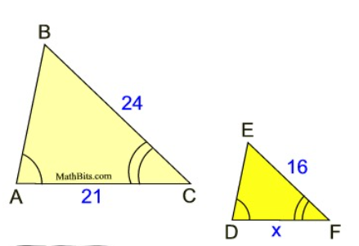
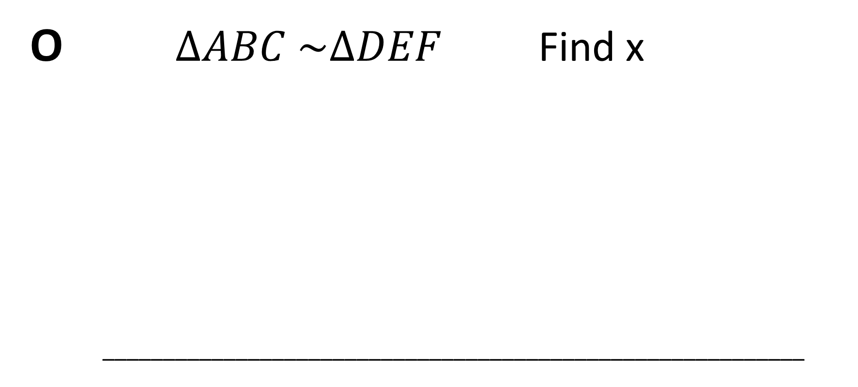
60
O $∆ABC \sim ∆DEF$ Find x
__________________________________________________________

Slide 16
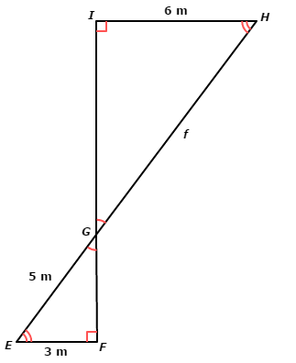

80
P $∆GHI \sim ∆GEF$ Find f
__________________________________________________________

Slide 17
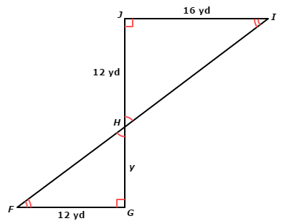
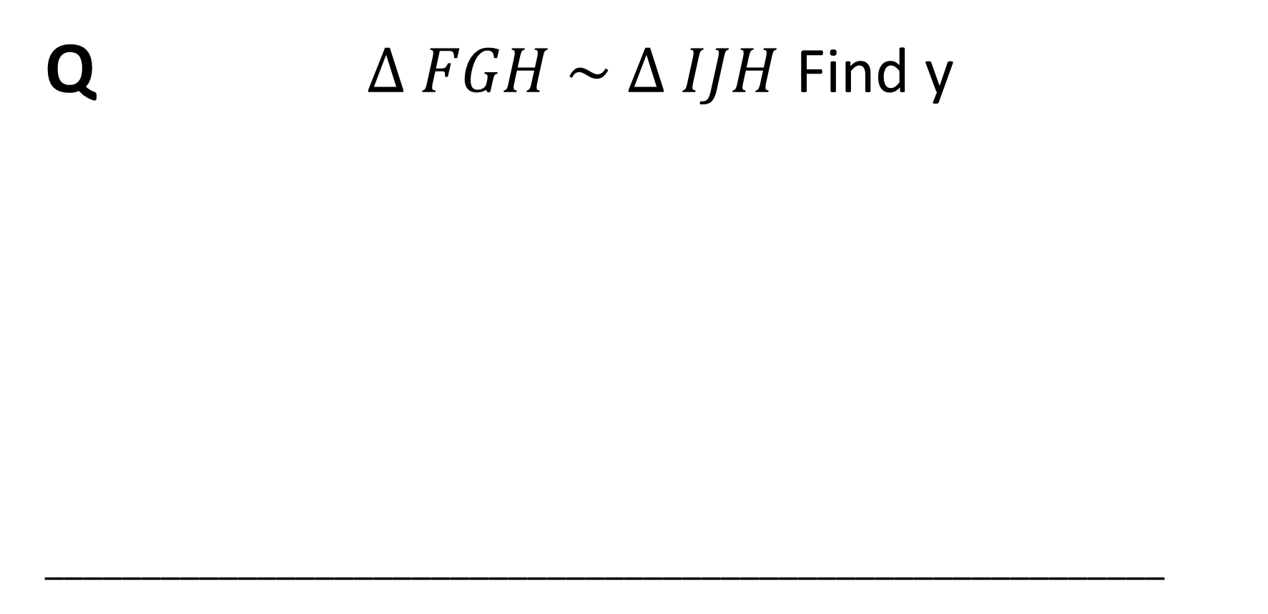
30
Q $∆ FGH \sim ∆ IJH$ Find y
__________________________________________________________

Slide 18
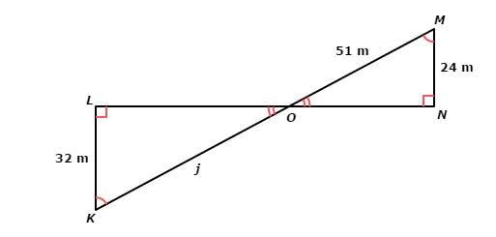

8
R $∆ MNO \sim ∆ KLO$ Find j
__________________________________________________________

Slide 19
56
S
__________________________________________________________

Slide 20
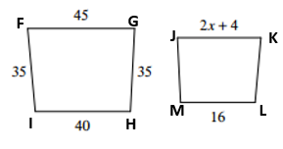
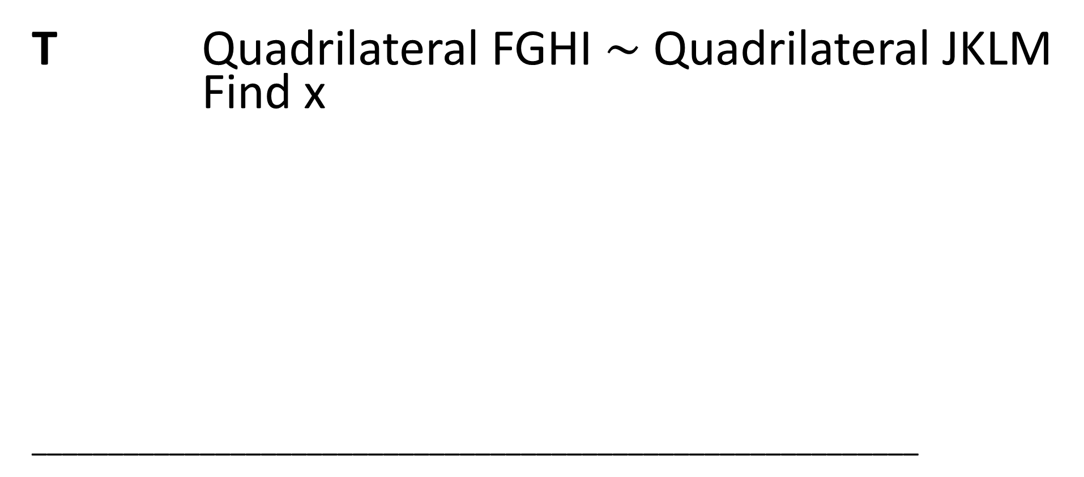
6
T Quadrilateral FGHI $\sim$ Quadrilateral JKLM Find x
__________________________________________________________

